Slide 1
Mining Frequent Patterns, Association and Correlations: Basic Concepts and Methods
CIS 468: Spring 2015

Slide 2
What is Frequent Pattern Analysis
Frequent pattern: a pattern (a set of items, subsequences, substructures, etc.) that occurs frequently in a data set
First proposed by Agrawal, Imielinski, and Swami [AIS93] in the context of frequent itemsets and association rule mining
Motivation: Finding inherent regularities in data
What products were often purchased together?— Beer and diapers?!
What are the subsequent purchases after buying a PC?
What kinds of DNA are sensitive to this new drug?
Can we automatically classify web documents?
Applications
Basket data analysis, cross-marketing, catalog design, sale campaign analysis, Web log (click stream) analysis, and DNA sequence analysis.

Slide 3
Why is Frequent Pattern Mining Important?
Freq. pattern: An intrinsic and important property of datasets
Foundation for many essential data mining tasks
Association, correlation, and causality analysis
Sequential, structural (e.g., sub-graph) patterns
Pattern analysis in spatiotemporal, multimedia, time-series, and stream data
Broad applications

Slide 4
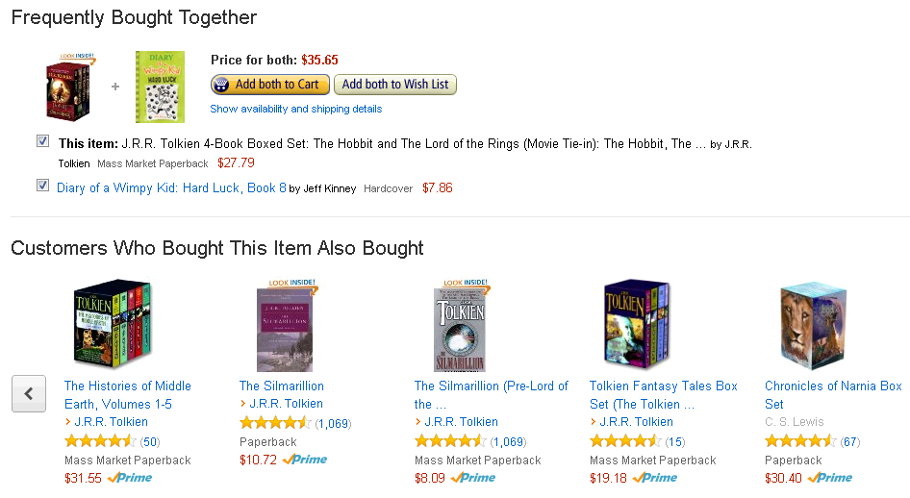
Frequent Itemsets
Frequently Bought Together
Customers who bought this item also bought

Slide 5
Basic Concepts: Frequent Patterns
Tid | Items bought
10 | Beer, Nuts, Diaper
20 | Beer, Coffee, Diaper
30 | Beer, Diaper, Eggs
40 | Nuts, Eggs, Milk
50 | Nuts, Coffee, Diaper, Eggs, Milk
itemset: A set of one or more items
k-itemset X = {x₁, …, x_{k}}
(absolute) support, or, support count of X: Frequency or occurrence of an itemset X
(relative) support, s, is the fraction of transactions that contains X (i.e., the probability that a transaction contains X)
An itemset X is frequent if X’s support is no less than a minsup threshold
Customer
buys both
Customer
buys diaper
Customer
buys beer

Slide 6
Basic Concepts: Association Rules
Tid | Items bought
10 | Beer, Nuts, Diaper
20 | Beer, Coffee, Diaper
30 | Beer, Diaper, Eggs
40 | Nuts, Eggs, Milk
50 | Nuts, Coffee, Diaper, Eggs, Milk
Find all the rules X → Y with minimum support and confidence
support, s, probability that a transaction contains X ∪ Y
confidence, c, conditional probability that a transaction having X also contains Y
Let minsup = 50%, minconf = 50%
Freq. Pat.: Beer:3, Nuts:3, Diaper:4, Eggs:3, {Beer, Diaper}:3
Association rules: (many more!)
Beer → Diaper (60%, 100%)
Diaper → Beer (60%, 75%)
Customer
buys both
Customer
buys diaper
Customer
buys beer

Slide 7
Closed Patterns and Max Patterns
A long pattern contains a combinatorial number of sub-patterns
Solution: Mine closed itemsets and max-itemsets instead
An itemset X is closed if X is frequent and there exists no super-pattern Y ⊃ X, with the same support as X
An itemset X is a max-itemset if X is frequent and there exists no frequent super-pattern Y ⊃ X
Closed pattern is a lossless compression of freq. patterns
Reducing the # of patterns and rules

Slide 8
Closed Itemset
Problem with maximal frequent itemsets:
Support of their subsets is not known – additional DB scans are needed
An itemset is closed if none of its immediate supersets has the same support as the itemset

Slide 9
Maximal vs. Closed Itemsets

Slide 10
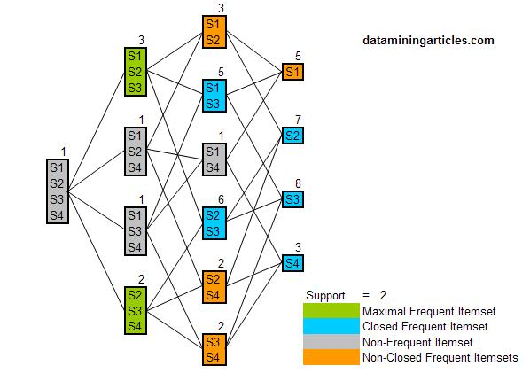
Maximal and Closed Frequent Itemsets
A-Close Algorithm
Pasquier, et al. @ ICDT’99

Slide 11
The Downward Closure Property and Scalable Mining Methods
The downward closure property of frequent patterns
Any subset of a frequent itemset must be frequent
If {beer, diaper, nuts} is frequent, so is {beer, diaper} and {beer,nuts}
The Apriori algorithm thrives on this property

Slide 12
Apriori: A Candidate Generation & Test Approach
Apriori pruning principle: If there is any itemset which is infrequent, its superset should not be generated/tested! (Agrawal & Srikant @VLDB’94, Mannila, et al. @ KDD’ 94)
Method:
Initially, scan DB once to get frequent 1-itemset
Generate length (k+1) candidate itemsets from length k frequent itemsets
Test the candidates against DB
Terminate when no frequent or candidate set can be generated

Slide 13
Apriori Principle
Found to be Infrequent
Pruned supersets

Slide 14
Apriori Principle
Items (1-itemsets)
Pairs (2-itemsets)
(No need to generate candidates involving Cola or Eggs)
Minimum Support = 3
Triplets (3-itemsets)
If every subset is considered,
⁶C₁ + ⁶C₂ + ⁶C₃ = 41
With support-based pruning,
6 + 6 + 1 = 13

Slide 15
The Apriori Algorithm
C_{k}: Candidate itemset of size k
L_{k} : frequent itemset of size k
L₁ = {frequent items};
for (k = 1; L_{k} !=∅; k++) do begin
C_{k+1} = candidates generated from L_{k};
for each transaction t in database do
increment the count of all candidates in C_{k+1} that are contained in t
L_{k+1} = candidates in C_{k+1} with min_support
end
return ∪_{k} L_{k};

Slide 16
The Apriori Algorithm (Example)
Mango – M
Onion – O
Nintendo – N
Key-chain – K
Eggs – E
Yo-yo – Y
Doll – D
Apple – A
Umbrella – U
Corn – C
Ice-cream - I
Transaction ID | Items Bought
T1 | {Mango, Onion, Nintendo, Key-chain, Eggs, Yo-yo}
T2 | {Doll, Onion, Nintendo, Key-chain, Eggs, Yo-yo}
T3 | {Mango, Apple, Key-chain, Eggs}
T4 | {Mango, Umbrella, Corn, Key-chain, Yo-yo}
T5 | {Corn, Onion, Onion, Key-chain, Ice-cream, Eggs}
Transaction ID | Items Bought
T1 | {M, O, N, K, E, Y }
T2 | {D, O, N, K, E, Y }
T3 | {M, A, K, E}
T4 | {M, U, C, K, Y }
T5 | {C, O, O, K, I, E}

Slide 17
The Apriori Algorithm (Step 1)
Count the number of transactions in which each item occurs
Item | No of transactions
M | 3
O | 3
N | 2
K | 5
E | 4
Y | 3
D | 1
A | 1
U | 1
C | 2
I | 1
Mango – M
Onion – O
Nintendo – N
Key-chain – K
Eggs – E
Yo-yo – Y
Doll – D
Apple – A
Umbrella – U
Corn – C
Ice-cream - I

Slide 18
Apriori Algorithm (Step 2)
Let’s say that an item is frequent if it occurs in 60% of the transactions.
In step 2 we simply remove any items that are bought less than 3 times.
Mango – M
Onion – O
Nintendo – N
Key-chain – K
Eggs – E
Yo-yo – Y
Doll – D
Apple – A
Umbrella – U
Corn – C
Ice-cream - I
Item | Number of transactions
M | 3
O | 3
K | 5
E | 4
Y | 3

Slide 19
Apriori Algorithm (Step 3)
Start making pairs from the first item (M) and the second item (O) and so on...
Mango – M
Onion – O
Nintendo – N
Key-chain – K
Eggs – E
Yo-yo – Y
Doll – D
Apple – A
Umbrella – U
Corn – C
Ice-cream - I
Item pairs
MO
MK
ME
MY
OK
OE
OY
KE
KY
EY

Slide 20
Apriori Algorithm (Step 4)
Count how many times each pair appears together in a transaction
Mango – M
Onion – O
Nintendo – N
Key-chain – K
Eggs – E
Yo-yo – Y
Doll – D
Apple – A
Umbrella – U
Corn – C
Ice-cream - I
Item Pairs | Number of transactions
MO | 1
MK | 3
ME | 2
MY | 2
OK | 3
OE | 3
OY | 2
KE | 4
KY | 3
EY | 2

Slide 21
Apriori Algorithm (Step 5)
Remove all the L2 transaction pairs that occur less than 3 times and we are left with the following:
Mango – M
Onion – O
Nintendo – N
Key-chain – K
Eggs – E
Yo-yo – Y
Doll – D
Apple – A
Umbrella – U
Corn – C
Ice-cream - I
Item Pairs | Number of transactions
MK | 3
OK | 3
OE | 3
KE | 4
KY | 3

Slide 22
Apriori Algorithm (Step 6)
Form sets of three items using the self join rule.
For each item pair we find two items with the same first item and join them
OK and OE = OKE
Item Set | Number of transactions
OKE | 3
KEY | 2

Slide 23
Association Rules
Body ==> Consequent [ Support , Confidence ]
Body: represents the examined data.
Consequent: represents a discovered property for the examined data.
Support: represents the percentage of the records satisfying the body or the consequent.
Confidence: represents the percentage of the records satisfying both the body and the consequent to those satisfying only the body.

Slide 24
Rule Generation
Given a frequent itemset L, find all non-empty subsets f ⊂ L such that f → L – f satisfies the minimum confidence requirement
If {O,K,E} is a frequent itemset, candidate rules:
{O,K} →{E}, {O,E} →{K}, {K,E} →{O}, {K} → {O,E}, {E} → {O,K},
{O} → {K,E}, {O} → {K}, {O} → {E}, {K} → {O}, {K} → {E},
{E} → {O}, {E} → {K}
If |L| = k, then there are 2^{k} – 2 candidates association rules (ignoring L → ∅ and ∅ → L)

Slide 25
Confidence and Association Rules
Body ==> Consequent [ Support , Confidence ]
{O,K} →{E}
{O,E} →{K}
{K,E} →{O}
{K} → {O,E}
{E} → {O,K}
{O} → {K,E}
{O} → {K}
{O} → {E}
{K} → {O}
{K} → {E}
{E} → {O}
{E} → {K}
Confidence = Body and Consequent / Body
Transaction ID | Items Bought
T1 | {M, O, N, K, E, Y }
T2 | {D, O, N, K, E, Y }
T3 | {M, A, K, E}
T4 | {M, U, C, K, Y }
T5 | {C, O, O, K, I, E}

Slide 26
Rule Generation
How to efficiently generate rules from frequent itemsets?
In general, confidence does not have an anti-monotone property
c(ABC →D) can be larger or smaller than c(AB →D)
But confidence of rules generated from the same itemset has an anti-monotone property
e.g., L = {A,B,C,D}: c(ABC → D) ≥ c(AB → CD) ≥ c(A → BCD)
Confidence is anti-monotone w.r.t. number of items on the RHS of the rule

Slide 27
Rule Generation
Lattice of rules
Low Confidence Rule
Pruned Rules

